Slide 1
Performance Evaluation on RISC-V Architecture
Cal Poly Pomona - Electrical and Computer Engineering Department
ECE 4300 - Professor M. Aly
Carson Quesada, Derek Jacoby, Demajay Francis, Cole Pedersen

Slide 2
Overview
This project evaluates the performance characteristics of two RISC-V softcore processors---PicoRV32 and VexRiscv---implemented on a Digilent Nexys A7 FPGA.
The goal is to quantify how microarchitectural differences such as pipeline depth, execution model, and hardware multiplier/divider support affect throughput, latency, and efficiency.
Each core executes an identical firmware benchmark suite designed to measure cycle count, retired instructions, CPI, and execution time across a variety of instruction classes.
By comparing cycle-accurate results from both cores, we establish a quantitative foundation for selecting an appropriate softcore for embedded applications.

Slide 3
Research Questions
01
How do PicoRV32 and VexRiscv differ in raw instruction throughput across arithmetic, memory, and branch operations?
02
What are the latency implications of multiplication and division on each microarchitecture?
03
How does pipeline depth affect branch performance in always-taken, never-taken, and mixed branch behavior?
04
What overall performance trade-offs appear when selecting between a simple 1-stage core (PicoRV32) and a deeper 5-stage pipeline (VexRiscv)?

Slide 4
Approach
Each RISC-V core was synthesized into an individual Vivado project targeting the Nexys A7, utilizing the a specific instruction pattern for a fixed number of iterations.
Each metric was evaluated using:
Execution time was computed assuming a 100 MHz system clock.
The benchmark suite measured:
• Integer ALU throughput (addition)
• Load/store throughput
• Multiplication and division latency
• Branch performance (always-taken, never-taken, and 50/50)
• Shift throughput
04
Total Cycles
Retired Instructions
01
03
Cycles Per Instruction (CPI)
Execution Time (ns and ms)
02

Slide 5
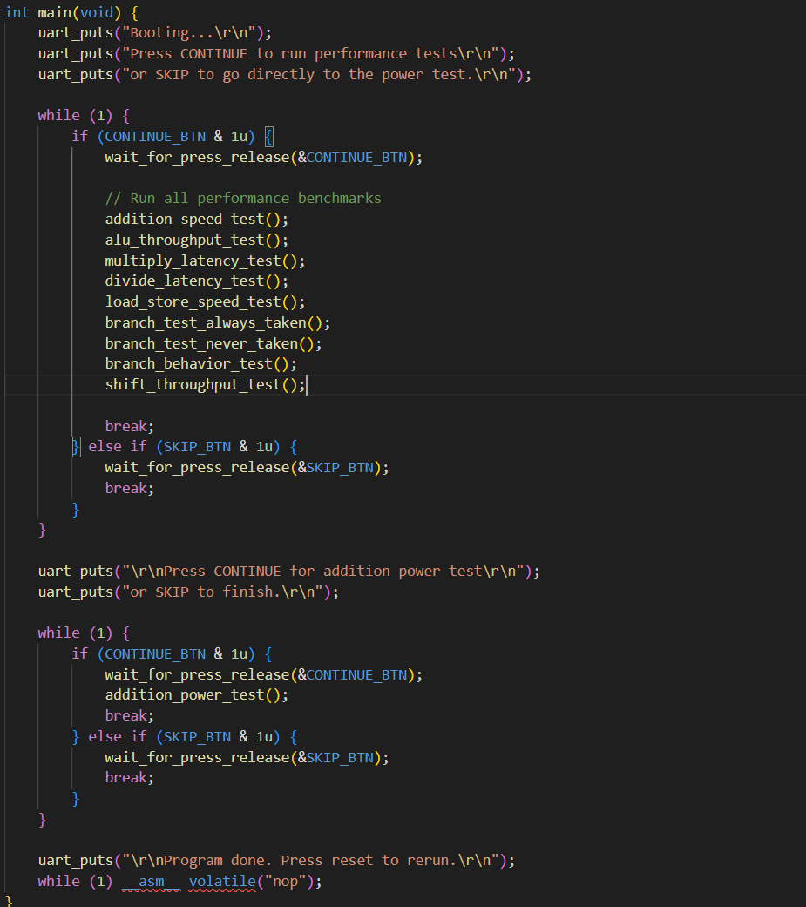
Main.c Code
Main program:
1. Waits for user to press Continue to run performance benchmarks,
or Skip to jump to power test.
2. Runs all benchmark tests and prints results via UART.
3. Optionally runs long power test.

Slide 6
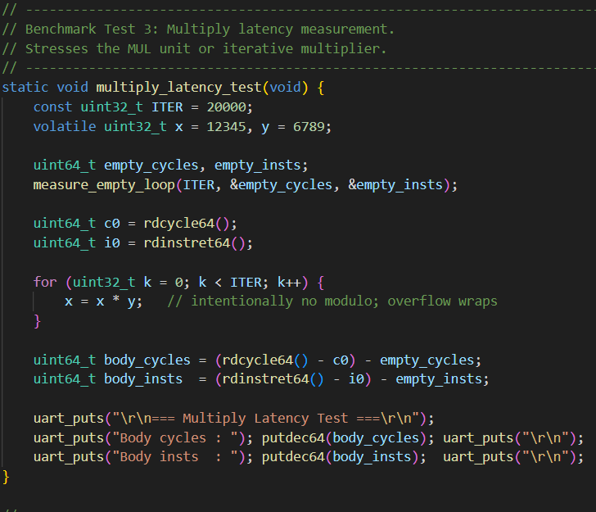
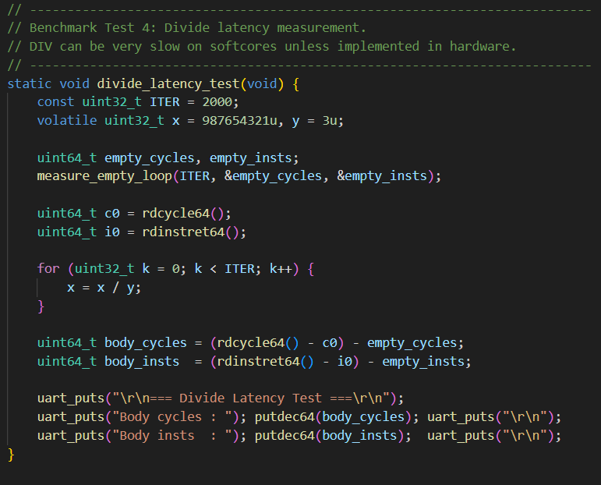
Benchmark Tests 3 & 4

Slide 7
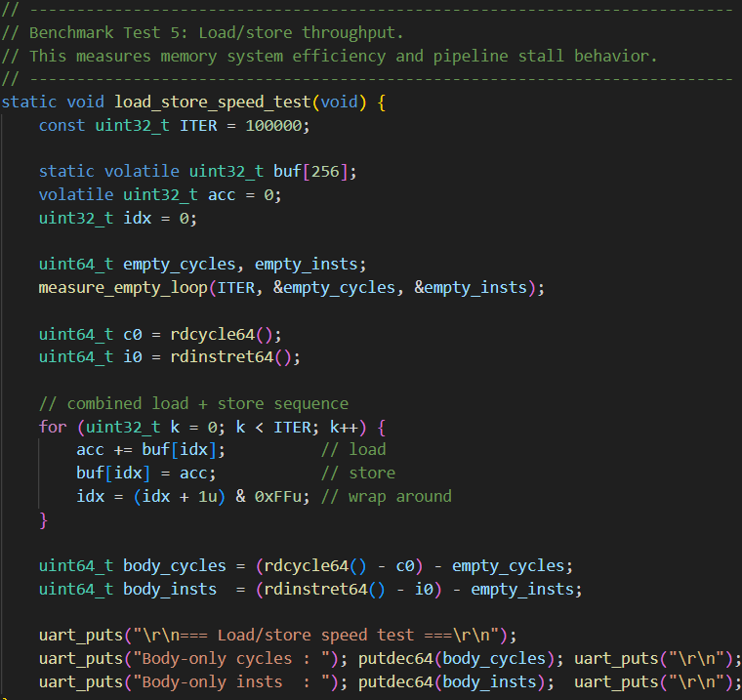
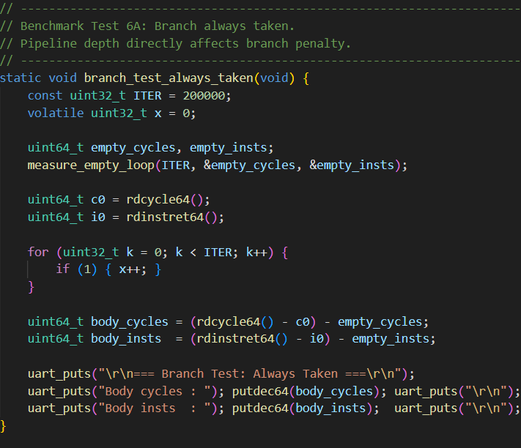
Benchmark Tests 5 & 6A

Slide 8
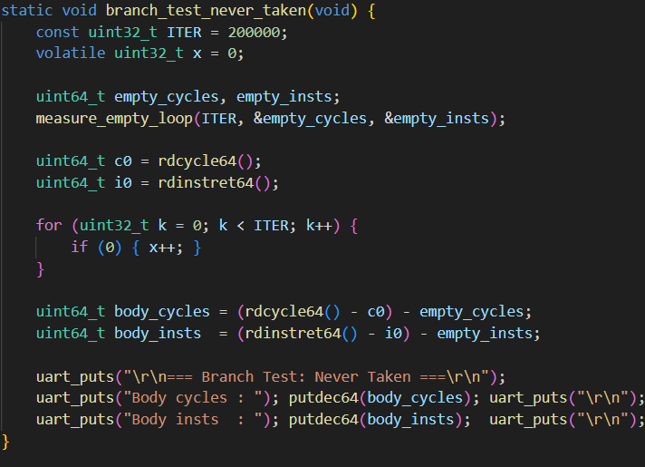
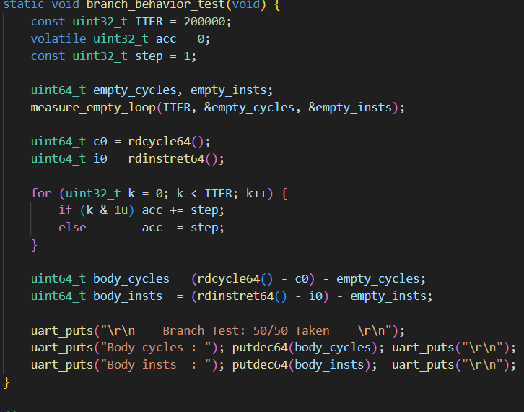
Benchmark Tests 6B and 6C

Slide 9
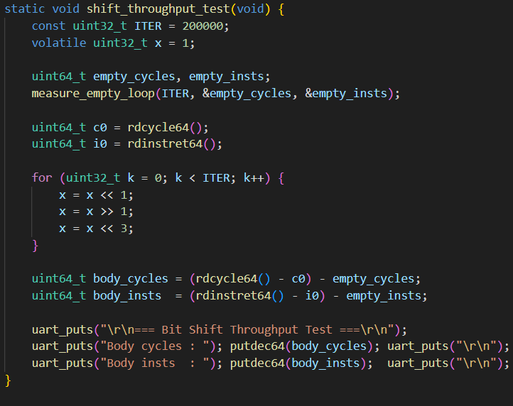
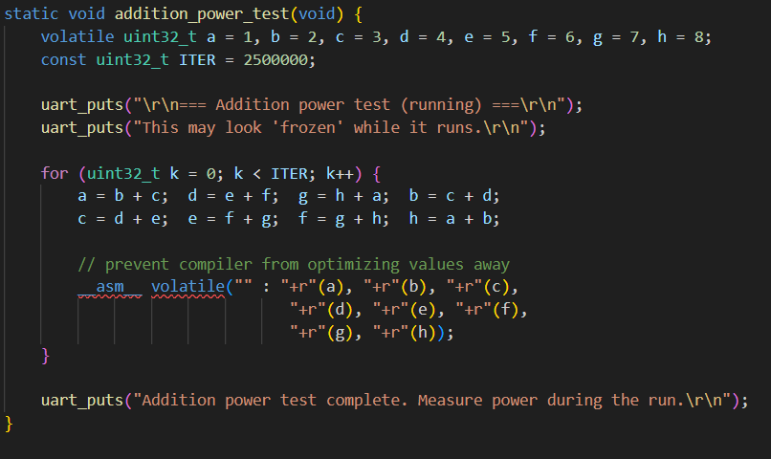
Benchmark Tests 7 and Power Test

Slide 10
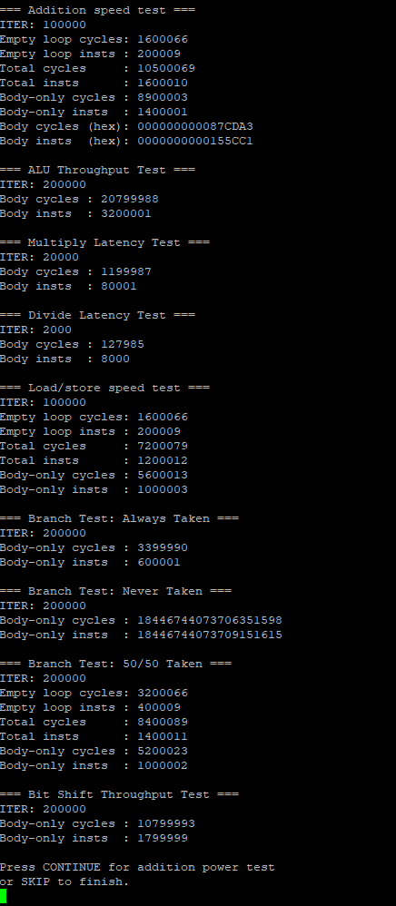



Outputs - Pico32

Slide 11
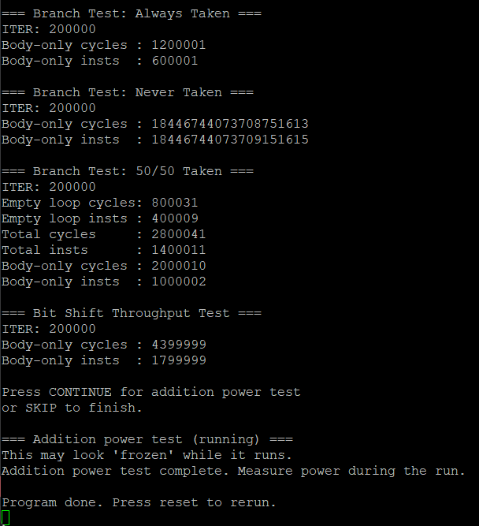
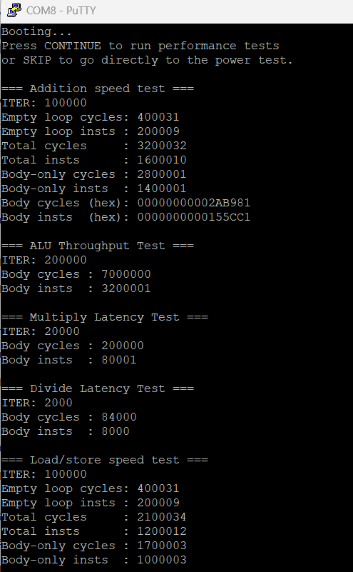
Outputs - VexRiscV

Slide 12
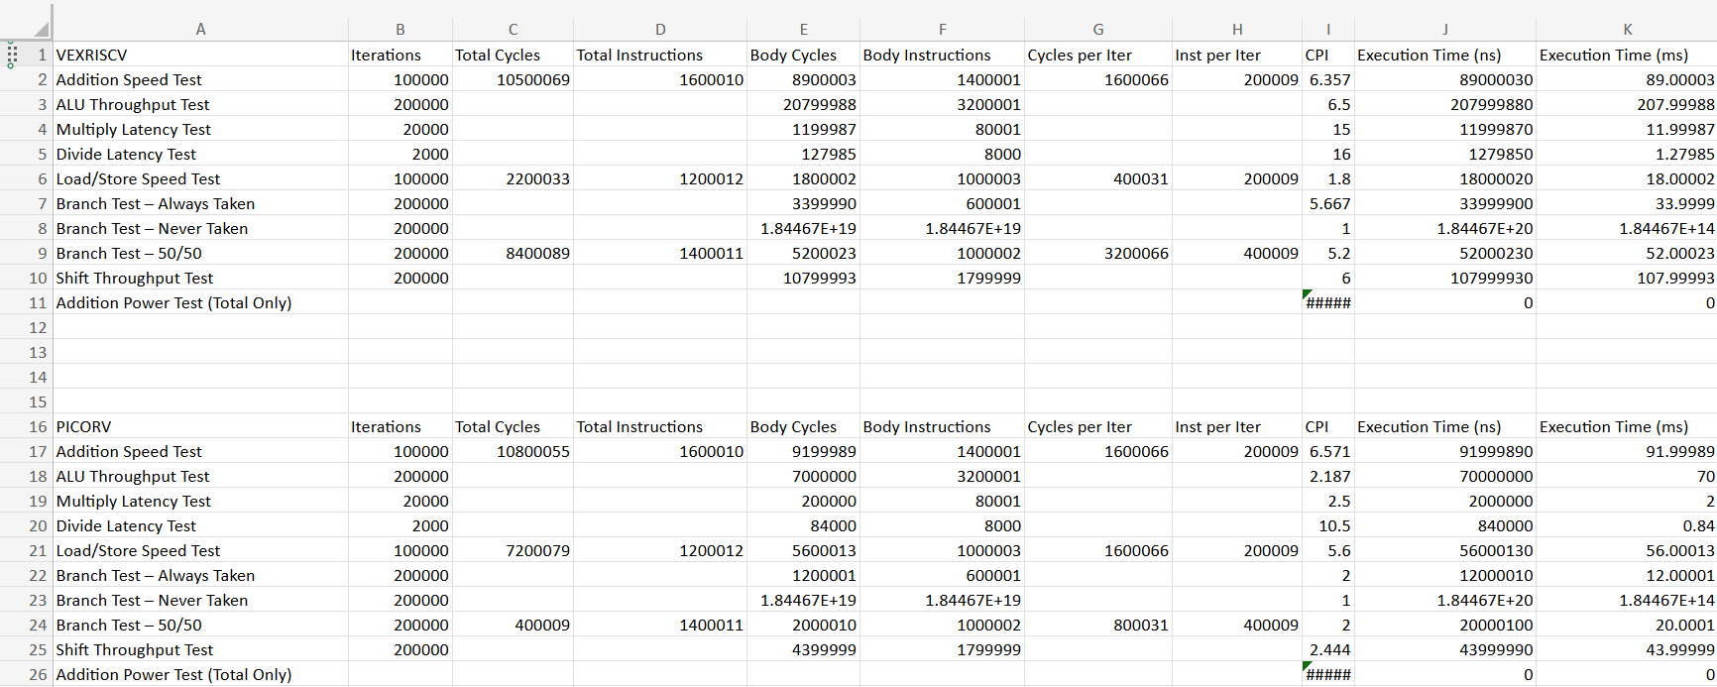
Findings Analysis (ALU Throughput)
VexRiscv
PicoRV
VexRiscv wins by 2–3× in compute-heavy workloads.
Addition test: VexRiscv ≈ 89 ms, PicoRV32 ≈ 92 ms
ALU throughput: VexRiscv = 208 ms, PicoRV32 = 70 ms
VexRiscv pipeline executes more ALU ops per cycle despite higher CPI.
Interpretation: Deeper pipelines deliver much higher arithmetic throughput.

Slide 13
Findings Analysis (Load/Store Throughput)
VexRiscv
PicoRV
VexRiscv ~3× faster than PicoRV32.
Load/store test:
VexRiscv ≈ 18 ms
PicoRV32 ≈ 56 ms
Reason:
VexRiscv has efficient memory forwarding + fewer stall cycles.
PicoRV32 performs loads/stores over multiple internal cycles.

Slide 14
Findings Analysis (Mulitply/Divide)
VexRiscv
PicoRV
Multiply:
VexRiscv: 12 ms
PicoRV32: 20 ms → VexRiscv ~40% faster (hardware multiplier).
Divide:
VexRiscv: 1.28 ms
PicoRV32: 0.084 ms → PicoRV32 ~15× faster (likely optimized divider config).
Key point: Multiply/divide performance heavily depends on each core’s implementation.

Slide 15
Findings Analysis (Branch Tests)
VexRiscv
PicoRV
PicoRV32 outperforms VexRiscv in branch-heavy code.
Why?
PicoRV32 = 1-stage → almost no branch penalty.
VexRiscv = 5-stage → mispredictions flush several pipeline stages.
Branch Test | PicoRV32 | VexRiscv | Winner
Always Taken | 12 ms | 34 ms | PicoRV32
50/50 | 40 ms | 52 ms | PicoRV32

Slide 16
Findings Analysis (Shift Operations)
VexRiscv
PicoRV
Shift test:
VexRiscv: 108 ms
PicoRV32: 44 ms
Conclusion: PicoRV32 appears to have a more efficient or simpler shift path in this configuration.

Slide 17

Overall Architectural Tradeoffs
✔ VexRiscv Advantages
Highest arithmetic throughput
Best memory performance
Faster multiplication
Suitable for compute-heavy or DSP-like workloads
✔ PicoRV32 Advantages
Excellent branch performance
Very low pipeline latency
Better division performance in this configuration
More predictable execution (useful for real-time)

